Slide 1
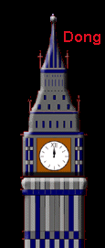
England

Slide 2
Tower of London

Slide 3
Tower Bridge

Slide 4
Stonehenge

Slide 5
House monumente

Slide 6
castle

