Slide 1
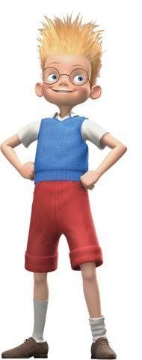
hair
eye
nose
ear
H
U
M
A
N
mouth
B
O
D
Y
neck
shoulder
arm
elbow
hand
fingers
leg
knee
foot

